Slide 1




Studying & profiling the GPU performances of 3D ray-marchers
Supervisor: Fabrice NEYRET
Student: HUYNH Danh Chieu Phu
Notes:
Good afternoon, I will present to you my project about “Studying…”
This project is under the supervising of professor Fabrice

Slide 2
Outline
Problem
Previous works
Difficulties
Our Approach
Our Experiments
Conclusion
Further research
Notes:
And this is the outline of the presentation:

Slide 3
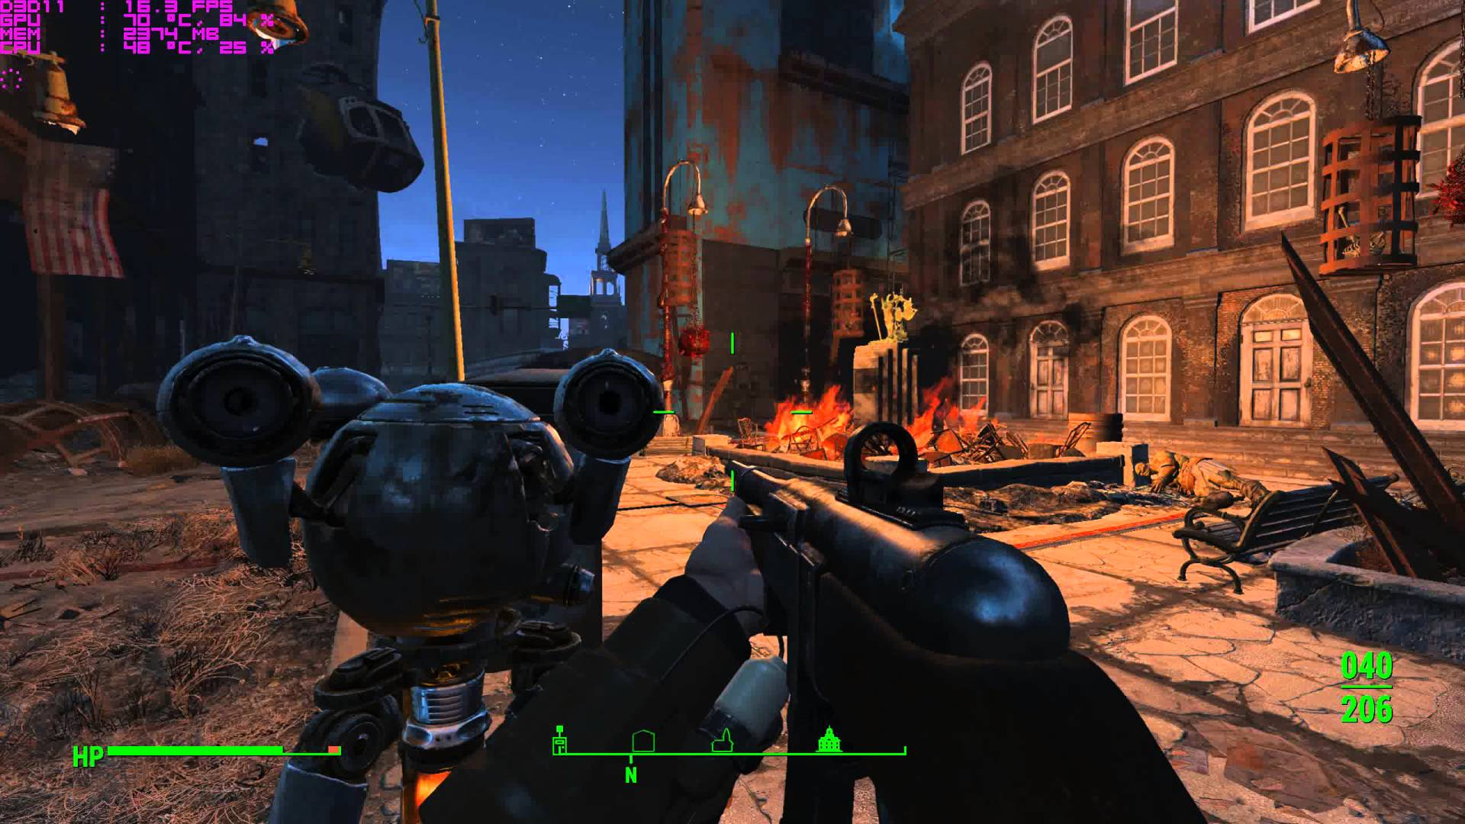
Problem
“The game FPS is always drop very slow when the camera facing at some direction” => what is the reason?
Notes:
Before studying here, I was a game programmer who had to optimize the performance in the games.
There are always a bug which is in some certain location in a game, when the main camera looks into a certain direction, the game performance always drops very low. Such as in this picture. Even, at the same location, but the main camera looks into other direction, this bug won’t happen.
This kind of bug appears in our games from time to time without any completely solution.
Raise the question to prof. => project “Studying &”
Hopefully with the knowledge learned from this project we will understand better this problem and find a way to fix it.

Slide 4
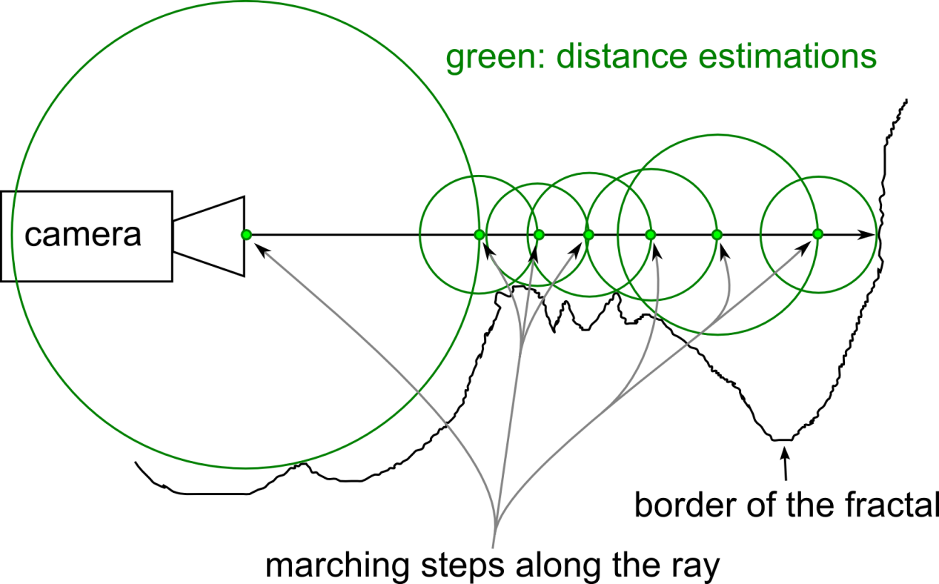
Previous work: Ray-marching
Ray-marching: A rendering technique that’s used widely in game programming.
Notes:
Ray marching is a rendering technique that is used widely in game programming because of its acceptable quality and low cost.
The idea of ray-marching is quite simple
To calculate the color of each pixel, instead of solving complex equations to find the intersection point, we simply walk along the camera ray little by little to find the intersection.

Slide 5
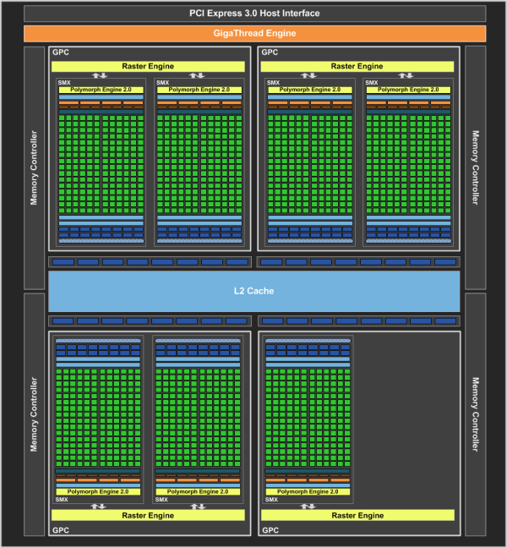
Previous work: Ray-marching
For the parallelism GPU
Nvidia GTX 670 is design with 7 SMs (Stream Multi-processor)
With total 1344 shader cores.
32 cores make a 1 warp
Every core in a warp starts and ends at the same time
8 warps make a tile
Every warps in a tile starts together
Does 1344 core really run in parallel?
Does it affect the rendering performance?
Notes:
To improve the rendering performance, the GPU is designed to do the rendering of 1000s pixel at the same time.
Such as: …

Slide 6
Difficulties
GPU shader is a closed process whose the output is only a color vector of 4 float number RGBA of a pixel.
Color buffer’s precision is very limit which may loose the precious information
Notes:
Them 1 tam hinh o day

Slide 7
Our Approach
Use OpenGL extension for the info
Encode the info to color
Read the color buffer => retrieve the info
Analyze the info
Make conclusion

Slide 8
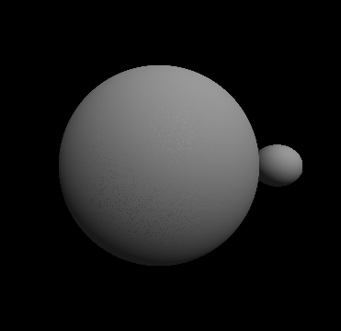
Our Experiments: Algorithmic cost
  The number of steps => Gray map
Notes:
Count the number of loop => gray value

Slide 9
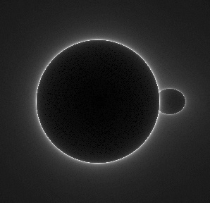
Our Experiments: Algorithmic cost
  The number of steps => Gray map

Slide 10
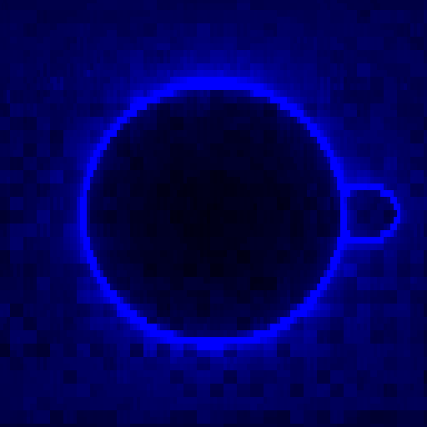
Our Experiments: Time cost
Use Nvidia’s OpenGL exten-
sion to get the GPU time.
Blue color = elapsed time

Slide 11

Our Experiments: Time cost
Use Nvidia’s OpenGL exten-
sion to get the GPU time.
Blue color = start/end time
Use another extension to
get the id of warp and sm
Red = SM id
Green = Warp id

Slide 12
Our Experiments: Time cost
Blue color = start/end time
Red = SM id
Green = Warp id
R = SM ID G = warp ID B = start time A = 0 | R = SM ID G = warp ID B = end time A = 0 | R = SM ID G = warp ID B = end time A = 0 | R = SM ID G = warp ID B = end time A = 0
R = SM ID G = warp ID B = end time A = 0 | R = SM ID G = warp ID B = end time A = 0 | R = SM ID G = warp ID B = end time A = 0 | R = SM ID G = warp ID B = end time A = 0
R = SM ID G = warp ID B = end time A = 0 | R = SM ID G = warp ID B = end time A = 0 | R = SM ID G = warp ID B = end time A = 0 | R = SM ID G = warp ID B = end time A = 0
…

Slide 13
Our Experiments: Time cost
The color buffer’s got low precision
=> New encode strategy
Output value in fragment shader | Value receive in the color buffer
0.111 | 0.109804
0.345 | 0.345098
0.346 | 0.345098
0.347 | 0.345098
0.548 | 0.549020
0.549 | 0.549020
0.550 | 0.549020
… | ...
R = SM ID G = warp ID B = 1 A = 0 | R = 0.1 G = 0.2 B = 0.3 A = 0.4 | R = 0.5 G = 0.6 B = 0.7 A = 0.8 | R = SM ID G = warp ID B = 2 A = 0
R = SM ID G = warp ID B = 3 A = 0 | R = 0.1 G = 0.2 B = 0.3 A = 0.4 | R = 0.5 G = 0.6 B = 0.7 A = 0.8 | R = SM ID G = warp ID B = 4 A = 0
No use | No use | No use | No use
…
Notes:
When reading the colorbuffer, if we found those key, we know that there are important information nearby then we start a procedure

Slide 14
Our Experiments: Time line
Notes:
56% is idle time => not effecient

Slide 15
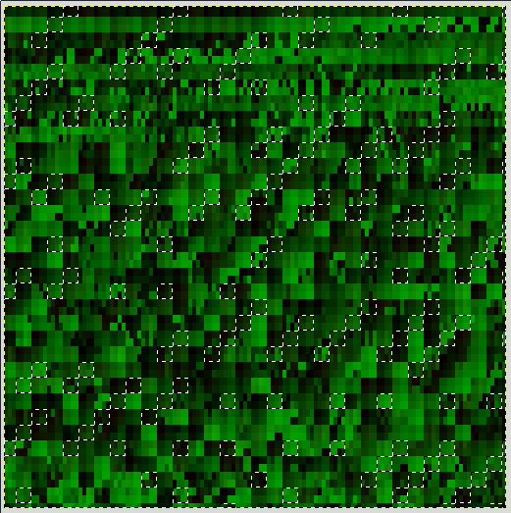
Our Experiments: Time line
8 nearby warps in the screen of the same SM group make a tile
4 group of SM that share task: SM 0-4, SM 1-5, SM 2-6 and SM 3
The warps in the same tile start together.
A tile has to finish all task before start a new one
These constrains may break the parallelisms
Notes:
One more thing,
As mentioned above, the 8 nearby warps will be handle by the same SM. But some time they may share the task with other SM in the same group.

Slide 16
Our Experiments: Time-line
Notes:
To highlight the relation between the warps in the same tile, we propose “coloring”

Slide 17
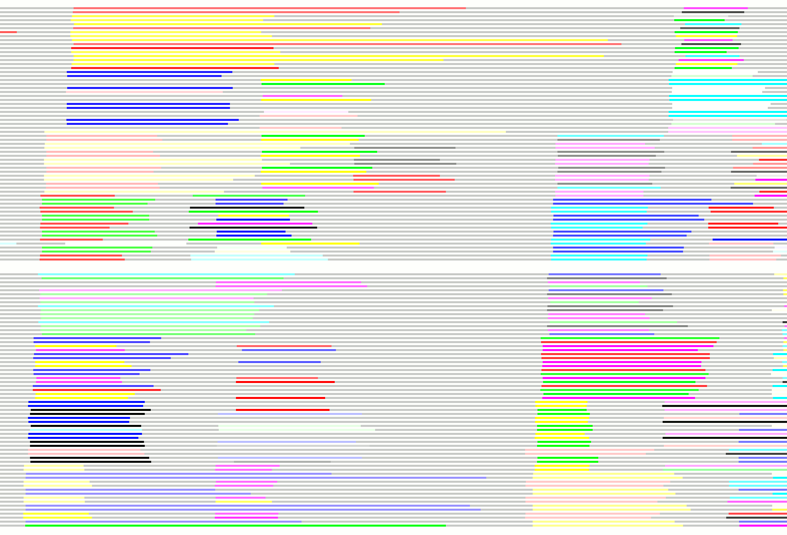
Analyzation
The warps in the same block will start at the same time,
If all 7 warps finished their task they still have to wait for the last one before starting any new task.

Slide 18
Conclusion
Because of the algorithms of Ray-marching, rendering cost of the object’s silhouette is very high.
The warps in the same block will start at the same time, if all 7 warps finished their task they still have to wait for the last one before starting any new task.
This breaks the parallelism of GPU
=> Because of this, a few complex pixels may hugely impact the rendering performances

Slide 19
Further research
Explain about the idle time between warp calls
Improve the visualization of the time-line

Slide 20
Thank you

